Slide 1
Some thoughts on The ID/LOC Split
David Freedman – Network Manager
Claranet Technology Group

Slide 2
Addressing the problems
RIB/FIB Size
Multihoming
Mobility
IPv4 Exhaustion
Can these all be tackled at the same time?

Slide 3
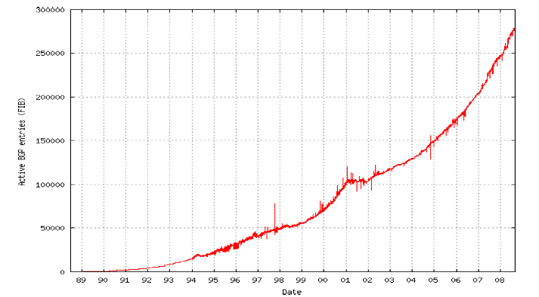
RIB/FIB Size
Not getting any smaller ☺
Because….

Slide 4
Multihoming and Mobility
Frequent Deaggregation due to Multihoming and Mobility
Provider Independent vs Provider Aggregatable, organisations want commercial freedom from provider but don’t want to renumber.
Deaggregation for Traffic Engineering Purposes
IP not designed to deal with this, moving an address block around (and creating multiple paths to it) is the cause of these scaling issues

Slide 5
And what of exhaustion?
RIR pools predicted to exhaust Feb 2011
Introduction of IPv6 (1995)
However IPv4 and IPv6 do not interoperate
Translation mechanisms exist for tunneling over IPv4 infrastructure but these are not successful interdomain

Slide 6
Looking at how we communicate
Alice instructs her application to speak with Bob’s application.
Alice makes a DNS request to find Bob’s application server, the DNS returns the IPv4 address of this machine and caches it according to Bob’s zone/record policy.
Alice initiates a TCP connection to Bob’s application server on Bob’s application port. The handshake completes and Alice speaks with Bob’s application.

Slide 7
Looking at how we communicate
Identifier
App -> OS :“I want app.bob.com:123 “
OS -> DNS : QUERY app.bob.com
DNS -> OS: REPLY 193.212.47.26
(84.26.206.3:2034) ->193.212.47.26:123
Locator

Slide 8
What does this MEAN?
The IDENTIFIER as an application developer is what I’m interested in. I don’t want to know about the underlying network, about IP addresses and how to reach them.
The LOCATOR as an operating system developer is what I’m interested in, I want to know where I should send my packets on the network

Slide 9
What does this MEAN?
Put this all together and your computers know roughly what they want.
They rely on the DNS to get them there most of the time
The DNS is the currently accepted way of getting from an IDENTIFIER to a LOCATOR
Or rather, put simply, we rely on the DNS to guide us through the network.
Assuming of course we can all accept using the DNS for this…

Slide 10
What’s wrong with the DNS?
Well, for starters, everything would have to go through it to receive its direction, no applications would be able to directly use IP addresses in configuration.
Also, caching would be out the window as it would prevent mobility (and as we all know turning caching off has serious implications)
Multihoming also doesn’t work in the DNS as the DNS can’t dictate routing policy or signal reachability
In short, hostnames as identifiers are not the solution, we need more help!

Slide 11
What are our alternatives here?
We have to use network or its addressing somehow to reinvent the concepts of identifier and locator.
But do we rewrite the address completely (and use mapping?) or encode the data in the address (and hope the application understands what we want!)
Rewriting the address completely means tunnelling, this is the premise of M&E (Map and Encap)
Encoding the locator in the address means we can avoid tunnelling (at the expense of the location), this is the premise of GSE (Generic Services Encapsulation).

Slide 12
LISP (draft-farinacci-lisp-11)
Locator/(Endpoint)ID Separator Protocol
Topological Routing Locators (RLOCs) for routing
Network BasedMap and Encap Solution
No changes to hosts whatsoever
No new addressing changes to site devices
Very few router configuration file changes
Address family agnostic
Developed implementation is LISP-ALT (draft-farnacci-lisp-alt-02)

Slide 13
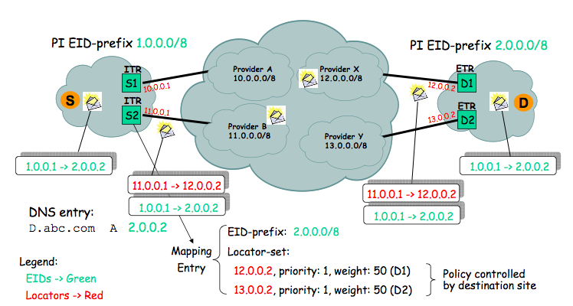
LISP Data plane

Slide 14
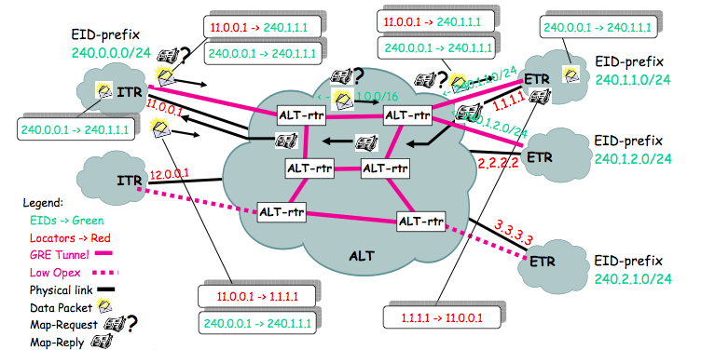
Mapping EID -> RLOC with LISP-ALT
ALT = The ALTernative network, BGP + GRE overlay for ALT mapping servers
ALT mapping signals ETR for ITR (xTR service)

Slide 15
LISP Possibilities
IPv6 EID with IPv4 RLOC
IPv4 EID with IPv6 RLOC
LISP Site to non LISP site
Multicast (S-EID, G) / (S-RLOC, G)
draft-lewis-lisp-interworking-01
draft-farnacci-lisp-multicast-00

Slide 16
LISP Implementations
Cisco NX-OS
Cisco IOS T Train
OpenLISP (usermode)
Linux Kernel (module) – Coming Soon
nb: IOS xTR being used by Facebook, visit http://www.lisp4.facebook.com

Slide 17
HIP (draft-ietf-hip-base-02.txt)
The Host Identity Protocol
Original goal to associate secure identities with hosts via cryptography (IPSec ESP)
End-To-End Communications via HIP secure ident
Approaches ID/Loc split from security perspective in addition.

Slide 18


The HIP Stack Paradigm
Process
Process
Transport
<IP Address, Port>
Transport
<Host ID, Port>
Host Identity
<Host ID>
IP layer
<IP Address>
IP layer
<IP Address>
Link layer
Link layer

Slide 19
The Host Identity
Known as “HIT” (Host Identity Tag)
128bit long hash value
HIT is a public crypto key!
Transport sockets bound to HITs not IPs
Kernel translates HIT - > IP
HITs can come from the DNS or opportunistically (i.e SSH)

Slide 20
HIP Possibilities
End to End Security
Secure Mobility / Multihoming
IPv4 / IPv6 Interworking
HIP Implementations
Kernel Support in FreeBSD, Linux, OpenSolaris, Windows

Slide 21
ILNP (undrafted)
Identifier Locator Network Protocol
Based on 8+8/GSE
Transport layer uses identifier, in this case 64 bits (taken from IPv6 address)
Locator uses the other 64 bits
Locator is used by kernel to route transport binding to IP endpoint

Slide 22
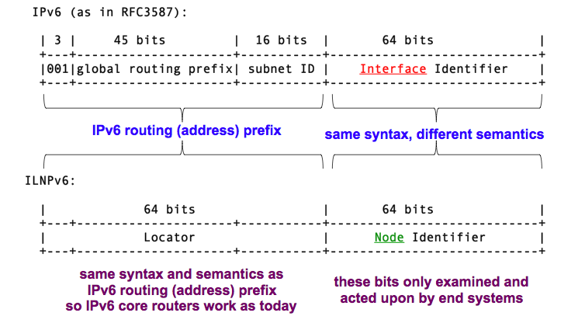
ILNPv6 Partitioning

Slide 23
DNS Enhancements Required though…
New RRs (ID/L64/PTRL/PTRI/LP)
Some of these records must have ZERO TTL
Secure DynDNS required for Locator Changes
ILNP Implementations
Specialist only (See http://ilnp.cs.st-andrews.ac.uk for further details)

Slide 24
Summary of Features
Feature | LISP | HIP | ILNP
Maturity | Production | Production (almost) | Experimental
Changes | Network | Host | Host
Site Renumber | No | Optional | Optional
Network Build | Yes | No | No
Network MTU | Increase | Retain | Retain
Reduce RIB/FIB | Yes | Yes | Yes
Mechanism | Mapping System | Inter Host | DNS
Modify Apps? | No | No | No
IPv4 | Yes | Yes | No
IPv6 | Yes | Yes | Yes
SiteMultihoming | Yes | Yes | Yes
Host Multihoming | No | No | Yes

Slide 25
Summary of Features
Feature | LISP | HIP | ILNP
Multicast | Yes | Yes | Yes
Traffic Engineering | Yes | Yes | Yes
Local Addressing | No | No | Yes
Mobile Hosts | No | Yes | Yes
Mobile Nets | No | No | Yes
Multipathing | No | No | Yes

Slide 26
Questions?

