Slide 1
IP Resource Certification
_________________________________________________
Andy Davidson adavidson@he.net
Hurricane Electric / LONAP / IXLeeds TREX Workshop 2011
16th September, Tampere, Finland

Slide 2
Resource Certification
Overview
Certifying my resources with the RIPE NCC
Verifying other’s resources on my equipment

Slide 3
We <3 routing, but we suck at it.
Accidental, huge customer impact
YouTube, Pakistan Telecom
AS7007
Unfiltered customers getting IP transit
Deliberate, criminal activity?
Defcon/Pilosov – stealing traffic
Originating darknets for spam (blacklisting)
L-Root clones, discovered with ICANN renumbered
Notes:
AS7007 – black hole caused when MAI Network Services (7007) leaked deaggregated /24s of the whole internet, back to the internet. BGP->RIP->BGP. http://www.merit.edu/mail.archives/nanog/1997-04/msg00444.html

Slide 4
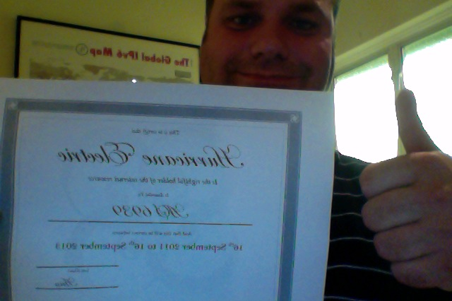
Certificates x509v3 and ROAs
Who owns?
Which Resource?
When?
According to?

Slide 5
ROA
Route Origin Authorisation
Not a certificate, a signed object.
Prefix holder’s explicit permission that a given prefix can be originated by a given ASN.
This gives me data to do Origin validation with.
SuperISP CA
___________________
10.0.0.0/8
AS65500
SuperISP EE
___________________
10.0.0.0/8
AS65500
ROA
___________________
10.0.0.0/8-16
AS65500

Slide 6
3 Step Process
Build a CA
Sign an EE
Publish a ROA
SuperISP CA
___________________
10.0.0.0/8
AS65500
SuperISP EE
___________________
10.0.0.0/8
AS65500
ROA
___________________
10.0.0.0/8-16
AS65500

Slide 7
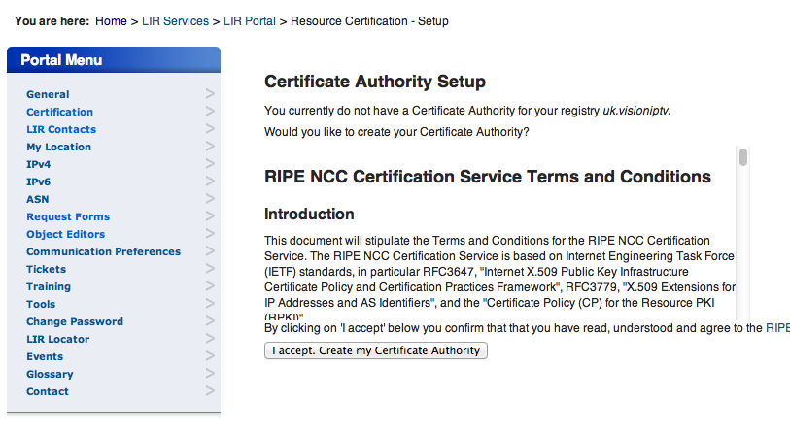
LIR PORTAL
Click on ‘Certification’
Your user needs Certification privs.

Slide 8
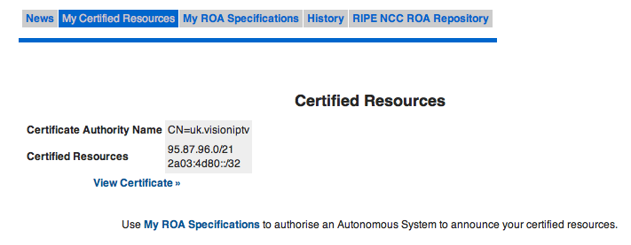
Clicking through to build your CA also creates certificates for your aggregate resources.

Slide 9
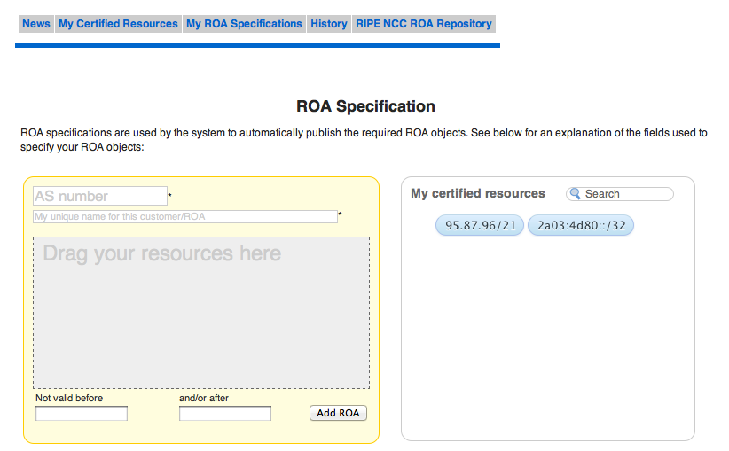
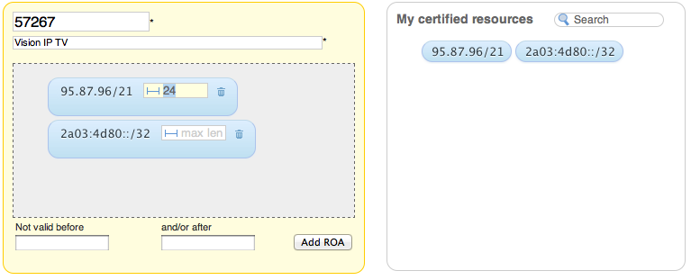
Drag and Drop your resources into the ROA Builder…

Slide 10
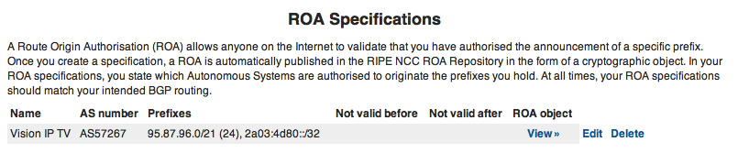
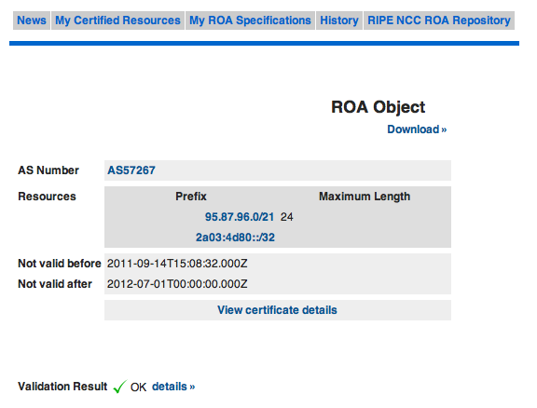

Slide 11
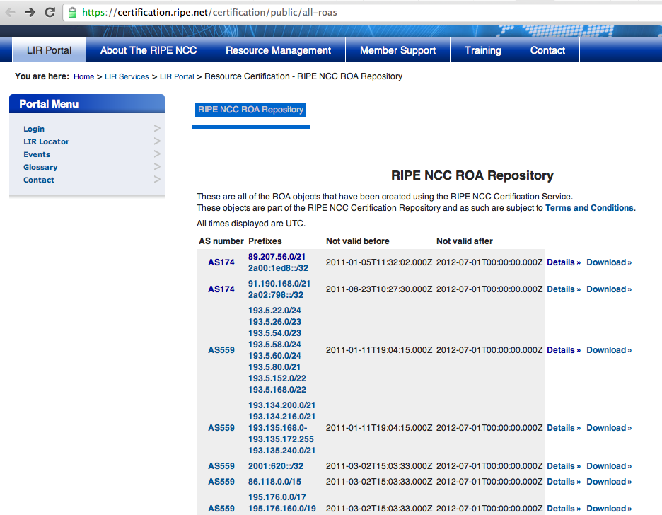

Slide 12
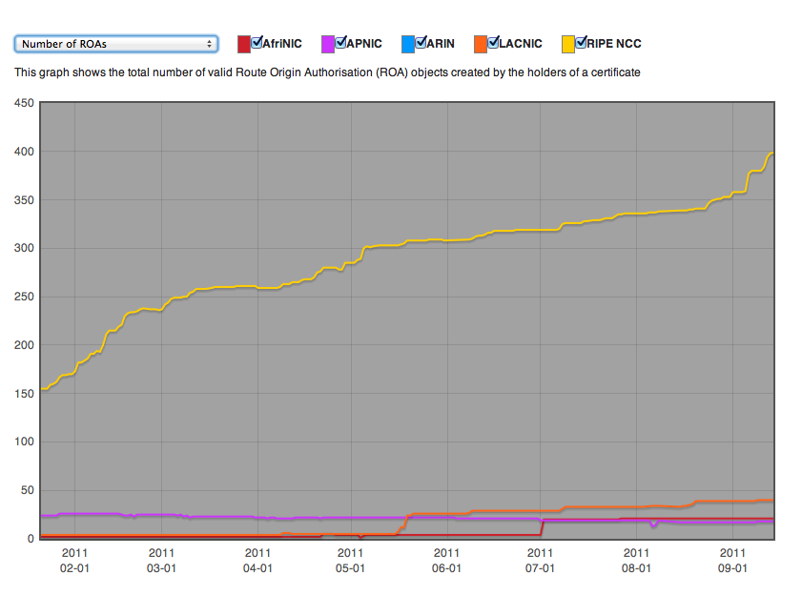

Slide 13
How can I verify others’ ROA?
Publishing CA
Publishing CA
ROA Cache
Router
Publishing CA
POLICY
Publishing CA
Routing Table

Slide 14
VALID
Matching ROA and AS Number
INVALID
Matching ROA found but AS number did not match!
I can write policies on my router
which cause different behaviours
depending on the response from
my RPKI cache….
NOT FOUND
No ROA

Slide 15
Example Router Configuration
router bgp 10
bgp log-neighbor-changes
bgp rpki cache 192.168.10.10 port-number 32000 refresh-time 5
network 192.168.10.0
neighbor 192.168.0.2 remote-as 20
neighbor 192.168.0.2 soft-reconfiguration inbound
neighbor 192.168.0.6 remote-as 66
neighbor 192.168.0.6 soft-reconfiguration inbound
neighbor 192.168.0.6 route-map PERMIT-INVALID in
route-map PERMIT-INVALID permit 10
match rpki-invalid
set local-preference 50
Make a valid alternative prefix become best-path.

Slide 16
Better Example with route-policy in XR
route-policy validity-0
if origin-validation-state is valid then
set local-preference 100
else set local-preference 50
endif
end-policy
route-policy validity-2
if origin-validation-state is valid then
set metric 100
elseif origin-validate-state is not-found
set metric 50
else set metric 25
endif
end-policy

Slide 17
One day safe?
route-map validity-0
match rpki-invalid
drop
route-map validity-1
match rpki-not-found
set localpref 1
See ya, sucker!!!!
Maybe I want an certified peer pfx to score lower than a valid route from transit..

Slide 18
Only import signed objects
route-map validity-0
match rpki-valid
set localpref 110
route-map validity-1
drop

Slide 19
Open Source ROA Processor
Publishing CA
https://subvert-rpki.hactrn.net/
http://www.rpki.net/
Publishing CA
ROA Cache
Router
Publishing CA
POLICY
Publishing CA
Routing Table

Slide 20
Not a magic bullet
Path Validation missing
Still vulnerable to MITM attacks.
Early code from vendors
Lots of testing work to do!
Address Policy, Trust relationships
RPKI – is it an “off” switch for networks?
Huge and paranoid organisations will want to run their own CAs, not the RIR one.

Slide 21
Questions ?
Feedback ?
Abuse ?

